Slide 1

BIRTHDAY WISHER BOT

Slide 2

Presented By-
Ankush Grover 21BCS2839
Shashi Ranjan Mehta 21BCS7093
Parth Gupta 21BCS3210
Paras Kaushik 21BCS7593
Prince Kumar Saini 21BCS2703
Varun Kumar Harsh 21BCS2613

Slide 3

is this ever happens with you “your someone close person birthday is tonight and you forgot him\her to wish happy birthday”

Slide 4

what is a bot??
You can say it Shortest Version of Robot
robots without bodies is bots
A bot is an application of AI used to automate tasks
To automate certain tasks

Slide 5

Types of bots
Spider bots
Spam bots
Social media bots\ chat bots
Download bots
Birthday wisher bots

Slide 6

History of bots
The first bot ever was developed by MIT professor Joseph Weizenbaum in the 1960s It was called ELIZA
The program was designed in a way that it mimics human conversation The bot ELIZA worked by passing the words that users entered into a computer and then pairing them to a list of possible scripted responses

Slide 7
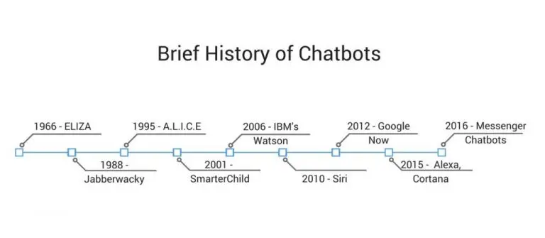

Slide 8

Advantages of bots
bots provide immediate feedback
Decrease human effort
Always available
Can gain wider profit in short period of time

Slide 9

Birthday wisher bots
It is a program basically used to wish and sent your blessing in form of text , photos , video and many more to your friends family and others
It can be also use to wish a anniversary new year wish also at any other occasion

Slide 10

Architecture of a Bot
Responder
AIML Interpreter
AIML Objects
The Bot

Slide 11

Features birthday wisher bot
You can use it for multi purpose just wishing anniversary new year or at other occasion by only changing some text in between

Slide 12
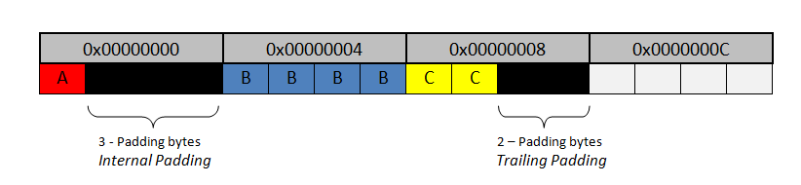

User can set date and time zone of their peoples according to their database

Slide 13

USers can add photos video and gif

Slide 14

Code
import pandas as pd
import datetime
import smtplib
GMAIL_ID = 'groverankush48@gmail.com’
GMAIL_PSWD = ‘***abc****’
def sendEmail(to,sub,msg):
print(f"Email to {to} sent with subject: {sub} and message {msg}" )
s = smtplib.SMTP('smtp.gmail.com',587)
s.starttls()
s.login(GMAIL_ID,GMAIL_PSWD)
s.sendmail(GMAIL_ID, to, f"subject : {sub}\n\n{msg}")
s.quit()

Slide 15

if _name=="main_":
sendEmail(GMAIL_ID,"subject","text message")
df = pd.read_excel("Book1.xlsx")
today = datetime.datetime.now().strftime("%d-%m")
for index, item in df.iterrows():
bday = item[‘Birthday'].strftime("%d-%m")
# print(bday)
if(today == bday):
sendEmail(item['Email'],"Happy Birthday",item['Dialogue'])

Slide 16
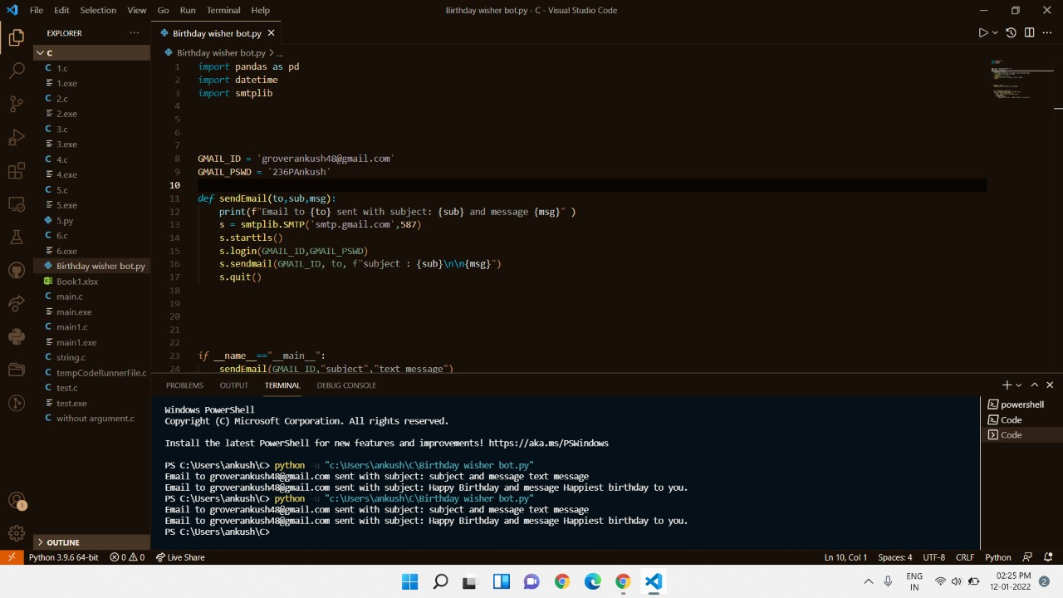
Outputs

Slide 17
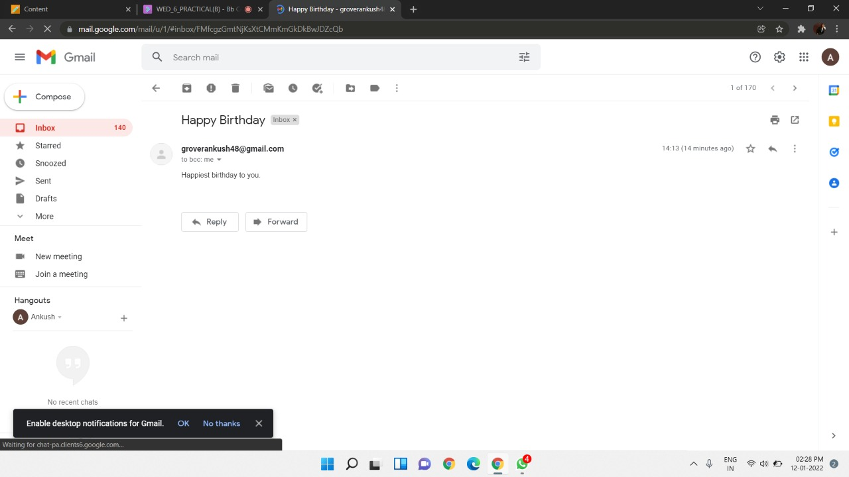

Slide 18

Code tools
INSTALL PANDAS
Pandas is just a library of python used for data manipulation
Python package providing fast, flexible, and expressive data structures designed to make working with “relational” or “labeled” data both easy and intuitive

Slide 19

INSTALL XLRD
Using xlrd module, one can retrieve information from a spreadsheet. For example, reading, writing or modifying the data can be done in Python. Also, the user might have to go through various sheets and retrieve data based on some criteria or modify some rows and columns and do a lot of work

Slide 20

SMPT CONNECTION
It has methods that support a full repertoire of SMTP and ESMTP operations. If the optional host and port parameters are given, the SMTP connect() method is called with those parameters during initialization. If specified, local_hostname is used as the FQDN of the local host in the HELO/EHLO command. Otherwise, the local hostname is found using socket.getfqdn(). If the connect() call returns anything other than a success code, an SMTPConnectError is raised. The optional timeout parameter specifies a timeout in seconds for blocking operations like the connection attempt (if not specified, the global default timeout setting will be used). If the timeout expires, TimeoutError is raised. The optional source_address parameter allows binding to some specific source address in a machine with multiple network interfaces, and/or to some specific source TCP port.

Slide 21

if _name=="main_“
Before executing code, Python interpreter reads source file and define few special variables/global variables. If the python interpreter is running that module (the source file) as the main program, it sets the special _name_ variable to have a value “_main”. If this file is being imported from another module, __name_ will be set to the module’s name. Module’s name is available as value to _name_ global variable.

Slide 22
Advantages of birthday wisher bots
You don’t need to remember anyone’s birthday
Bots will automatically wish
It can be further upgrade by adding video and gif to wish

Slide 23

Disadvantages of bots
Not Personalized or Emotive
Limited Function
Expensive to Install
We don’t have to dependent on the Ai machines this may lets to destroy human civilization

Slide 24


